Slide 1
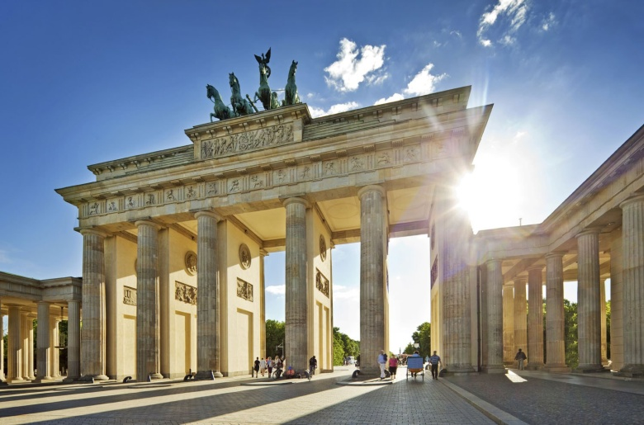
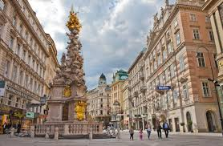
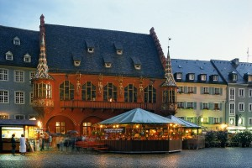
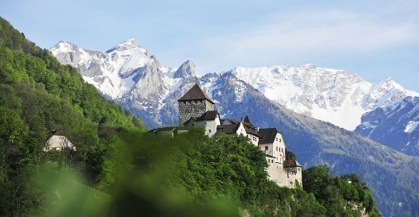
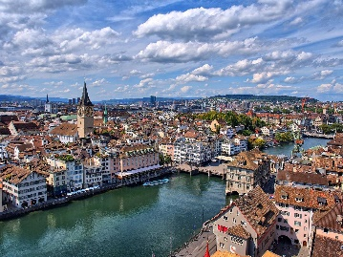
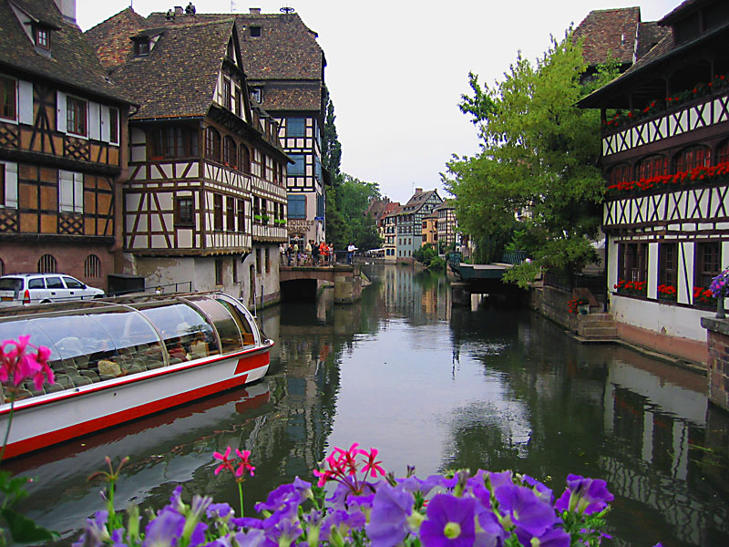
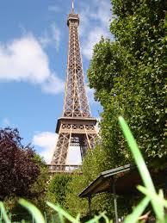
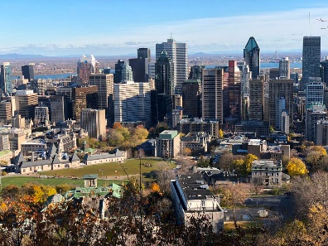
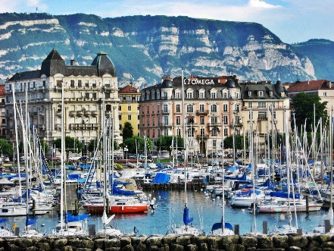
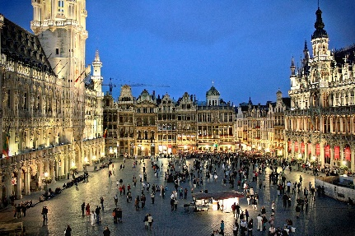
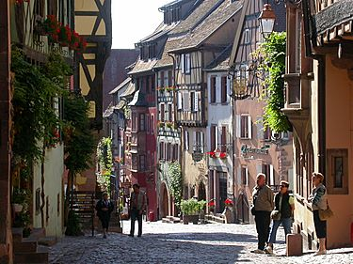
FRENCH AND GERMAN GCSE
Merano, Italy
Vienna, Austria
Berlin, Germany
Freiburg, Germany
Zürich, Switzerland
Liechtenstein
Strasbourg, France
Montréal, Canada
Paris, France
Geneva, Switzerland
Brussels, Belgium
Riquewihr, France

Slide 2
The proportion of the world that does not speak English as its first language is: -
1%
25%
74%
94%
What proportion of the world speaks NO ENGLISH AT ALL?
75%
60%
50%
25%
How many UK companies are losing business because of poor foreign language skills?
1 out of every 100
1 out of every 5
1 out of every 50

Slide 3
GCSE FRENCH AND GERMAN - STRUCTURE
LISTENING – 25%
READING – 25%
SPEAKING – 25%
Foundation – approx. 7 minutes long
Higher – approx. 10 minutes long
Your year 8 and 9 speaking tests are/were not far off that – NOTHING TO WORRY ABOUT
WRITING – 25%
Foundation – write a some short passages of between 35 and 90 words
– Some of my year 7s after 3 months of German or French write 100+ words in the writing exam before Xmas
– AGAIN NOTHING TO WORRY ABOUT
Higher – write three passages of 50 and 150 words

Slide 4
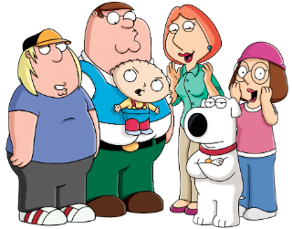
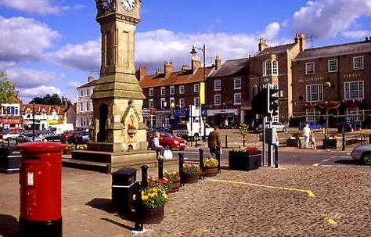
TOPICS
THE GOOD NEWS IS …
YOU HAVE BEEN DOING GCSE TOPICS FOR THE LAST THREE YEARS!!!!!
SOCIETY
THE ENVIRONMENT
HEALTH AND FITNESS
THE MEDIA

Slide 5
Learning Languages Opens a Door To The World
SOME REASONS For CONSIDERING GCSE FRENCH AND GERMAN
Develops language learning skills
Highly regarded qualification – Ebacc
Encourages tolerance of difference in a global world
Central skill to certain occupations – Modern Languages teaching, translation, interpreting
Useful extra skill to many other specialisms – business, journalism, tourism, law, science, engineering, communication

Slide 6
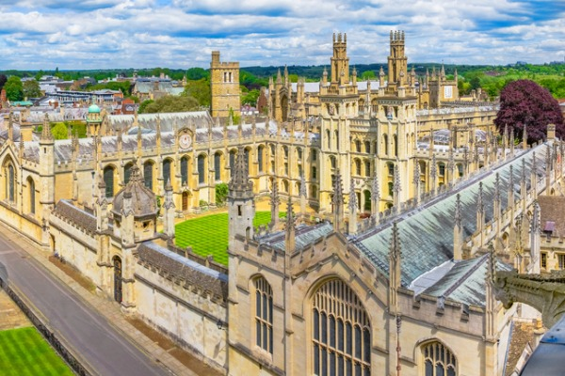
Thirsk Student A level successes in French and German, going on to study Languages or Linguistics at university
Laura Marwood – Durham University, PhD London University
Amber Welford – French and German, Aberystwyth University
Lizzie Lee – German and Philosophy, Oxford University
Maddison Coleman – German and Philosophy, London University
Jade Brown – German and Dutch, Sheffield University
Jamie Bailey – Linguistics – Cambridge University
Oliver Harrison – German, Spanish and Arabic, St Andrews
Archie Turner – French and German, Oxford University
Will Chandler – German and Spanish, University of Manchester
“Everyone thinks when they go abroad that everyone speaks English. Trust me, this is not the case. Whilst working in Paris I have made so many great friends and met same amazing people through speaking a foreign language, not just from France, but Costa Rica, Switzerland, Italy and Germany.” (Amber Welford – studied French and German at Thirsk and at university)
“Learning a language opens so many doors, for university, for jobs, for travel, for meeting new people.” (Bethany Suffield – worked in Switzerland and studied Business with a Foreign Language)

Slide 7
Further information or questions?
Speak to any of the MFL teachers
email andrew.acheson@thirskschool.org

